Slide 1
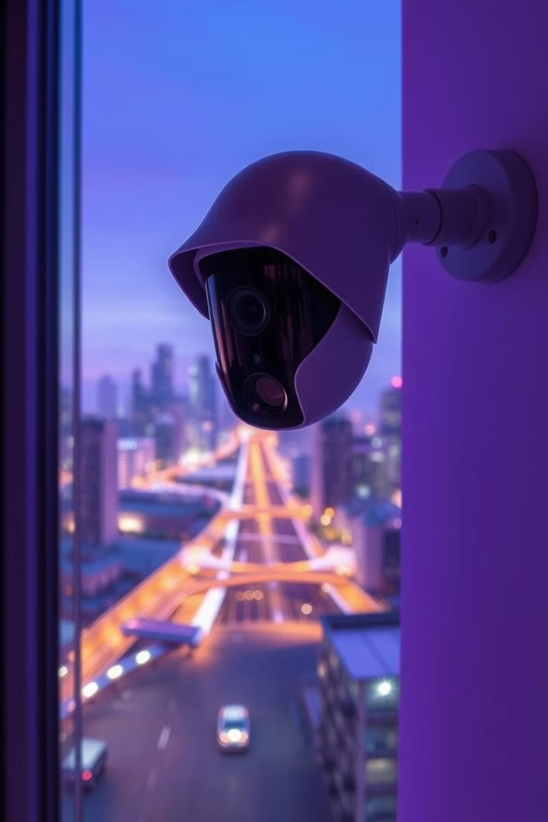
Secure Cam
A real-time human detection system for security applications.
Umar Farooq: 2022-CS-811
Muaz Sheikh: 2022-CS-820
Faaez: 2022-CS-836

Slide 2
Real-Time Human Detection
Efficient Detection
GOAL
Dynamic environments, YOLOv8, OpenCV.
Ensuring practical applicability in security
Performance Metric
Frames Per Second (FPS).

Slide 3
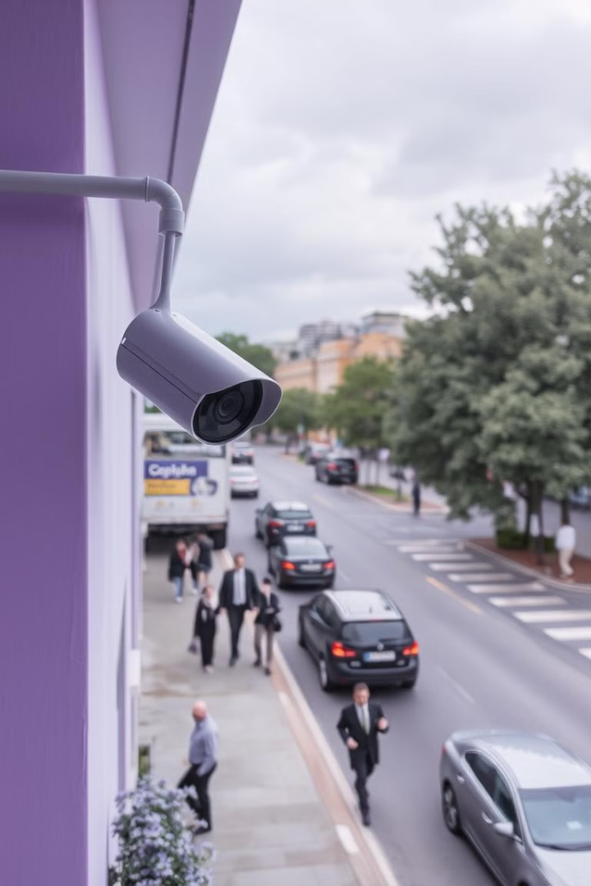
Introduction
1
Background
2
Importance
Identifies and localizes humans in live video streams.
Immediate response to threats, crowd management, intrusion detection.
3
Challenges
Balancing accuracy and speed
Managing lighting variations and occlusions

Slide 4

Methodology (Part 1)
YOLOv8 Architecture
Dataset
Faster inference, higher accuracy, flexible for custom datasets.
Roboflow Person Detect for diverse training scenarios.
Work Flow
Data Input > Preprocessing > Detection > Post-Processing

Slide 5
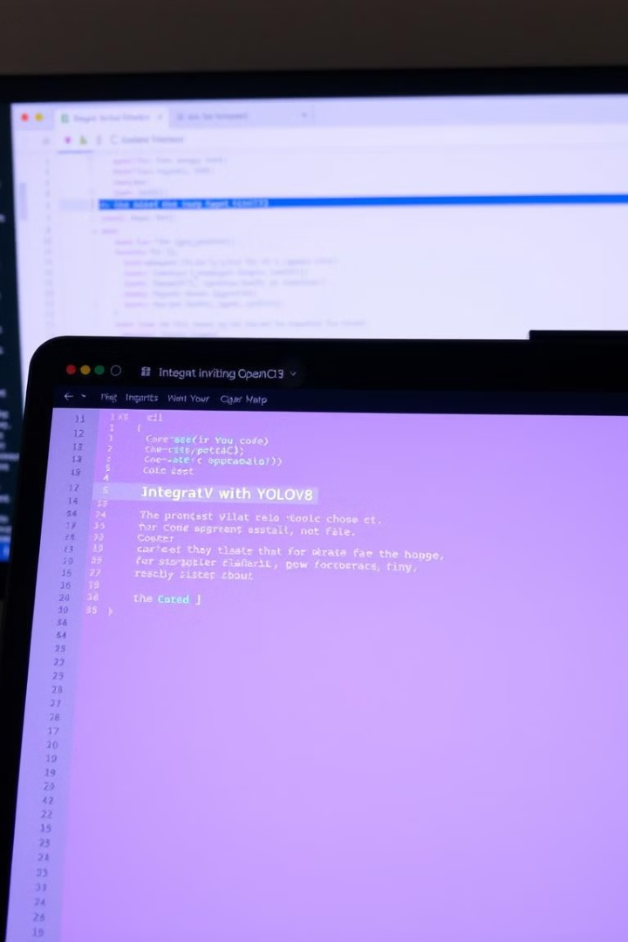



Methodology (Part 2)
OpenCV Integration
Performance Metrics
Video capture, frame-by-frame processing, real-time display.
FPS, latency per frame.
Hardware
Software
Google Colab GPU
Python YOLOv8 OpenCV

Slide 6
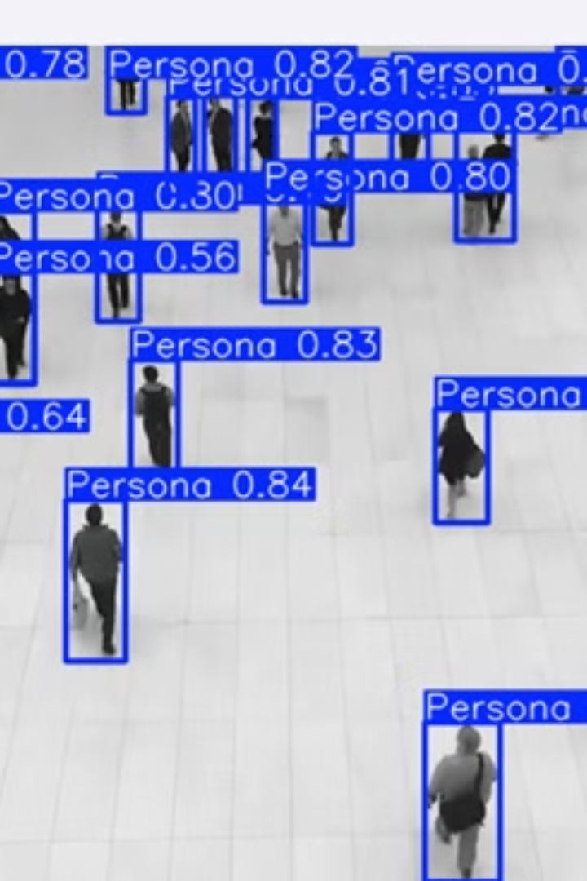
Results
1
Visual Results:
2
Comparative Analysis:
Bounding box illustrations of detected humans.
YOLOv8 outperformed traditional methods in speed and accuracy

Slide 7
Conclusion
Summary
1
Robust real-time detection system, effective for security applications.
Future Work
2
Optimize FPS, add multi-object detection and tracking, deploy on edge devices.

